Slide 1


NAAC B++ Accredited and ISO 9001:2015 Certified Institute
Sant Gajanan Maharaj College of Engineering
Site Chinchewadi, Mahagaon. Tal: Gadhinglaj, Dist: Kolhapur
Academic Year 2023-24
Department of Computer Science and Engineering
Final Year B. Tech Project Synopsis
On
“Uncovering Industrial Trends by analysing data Using Power BI”
Submitted By
Group No: SGMCOE/CSE/23-24/PRJ-I/13
Sr. No. | Name of the Student | PRN
1 | Borgave Revati Sanjay | 2020076665
2 | Patil Devendra Sunil | 2020081860
3 | Sutar Abhishek Rajaram | 2021076912
4 | Goilkar Rohan Ravindra | 2020080792

Slide 2
Table of Contents
Sr. No | Content | Page No.
1 | Abstract | 3
2 | Introduction | 4
3 | Rationale | 5
4 | Objectives | 6
5 | Literature Review | 7-8
6 | Feasibility Study | 9
7 | Methodology | 10-11
8 | Facilities required for proposed work | 12
9 | Expected outcomes | 13
10 | References | 14
11 | Project Planning | 15

Slide 3
Abstract
This project uses a special tool called Power BI to look at sales information for a skateboard company.
We want to find out what makes people buy skateboards and which places are best for selling them.
We'll also see if our ads and special deals are working. By doing this, we can make smarter choices to sell more skateboards and make the company even better.

Slide 4
Introduction
We're diving into a project to boost sales and smart decision-making for skateboard company.
Using a cool tool called Power BI, we'll look at company’s sales numbers, who's buying our boards, and how our marketing is doing.
The idea is to create dashboards that show us the important stuff in a clear and simple way. This way, we can make smarter choices, find out what our customers really like, and keep our skateboards rolling off the shelves!

Slide 5
Rationale
We are using Power BI tool to make the decision making easy. Using Power BI we will create the dashboard which will make the data view in understandable graphs.
From this, the company can make decisions which will be beneficial for their sales growth.

Slide 6
Objective
Data-Driven Decisions:
-Enable informed choices with real-time insights.
Boost Sales:
- Optimize product offerings and marketing based on trends.
Cut Returns:
- Minimize returns and improve product quality.
Targeted Marketing:
-Enhance market engagement through regional insights.

Slide 7
Literature Review
Title: Data Visualization for Developing Effective Performance Dashboard with Power BI
Author: Gurpreet Singh; Ankul Kumar; Jaspreet Singh; Jagdeep Kaur
Publisher: 2023 International Conference on Innovative Data Communication Technologies and Application (ICIDCA)
Abstract :
Data visualization is a very important step in data analysis as it provides insight into the data in a more effective manner that is interesting, simple, and understandable to every-one without any language barrier. It can also represent a huge amount of data in a small space very easily. In the previous two years, the whole world has suffered from a very terrifying nightmare known as COVID-19. Known to be starting from the country of China, the pandemic affected not only the health and well-being of mankind, but also had serious impacts on the economies of various countries. Hence, a visualization of the data set of the pandemic might provide beneficial insights for finding a possible solution and can help in overcoming the impacts of the pandemic.

Slide 8
Feasibility Study
Introduction:
The feasibility study represents the crucial initial phase of software engineering, wherein the viability, necessity, and significance of the project are assessed. This study provides the foundation for informed decision-making and project planning.
Feasibility Assessment:
Technical Feasibility: We will evaluate the technical requirements and capabilities needed for project development. This includes assessing whether the necessary technology, tools, and expertise are available or can be acquired within the project's constraints.
Financial Feasibility: A detailed financial analysis will be conducted to estimate the project's budget, resource needs, software license.

Slide 9
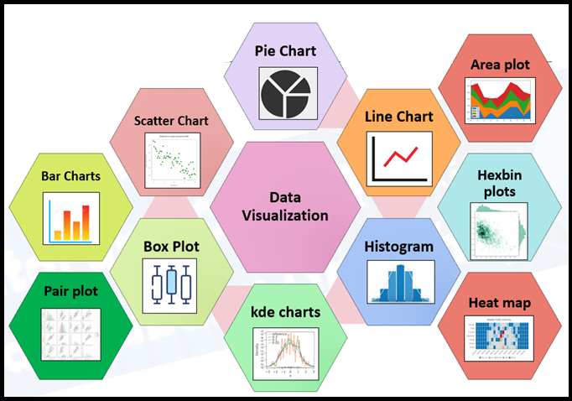
Methodology/ Planning of work Methodology
Project Scope
Data storing
Data cleaning
Data Transforming
Dashboard Design

Slide 10
Planning of Work
Clean and model data and Develop a data model.
Load data into Power BI, Design interactive dashboards, Analyze sales, customers, inventory, and marketing.
Create comprehensive reports, Prepare presentation for stakeholders.

Slide 11
Facilities required for proposed work
Hardware Requirement:
Processor : Intel core i3
Hard disk : Minimum 20GB
RAM : Minimum 4GB
Software Requirement :
Operating System: Windows 8
Dataset Storage: MySQL or SQL Server
BI Tool: Power BI, Power BI Report Services

Slide 12
Expected Outcomes
The Dashboard we have created will be launched on Power BI Report Services, from which it will get easy for company to go through the data view i.e. Dataset of their company.
From the presented Dashboard company can easily understand the requirements and the points which want to update and also regional wise trends.
SO, it will get easy to take decisions through the graphs for growth of their sales.

Slide 13
References
Paper:
Title: Data Visualization for Developing Effective Performance Dashboard with Power BI
Author: Gurpreet Singh; Ankul Kumar; Jaspreet Singh; Jagdeep Kaur
Publisher: 2023 International Conference on Innovative Data Communication Technologies and Application (ICIDCA)
Websites:
https://data.world/datasets/skate
https://www.microsoft.com/en-us/research/project/microsoft-research-open-data/
https://www.technavio.com/report/skateboard-market-analysis

Slide 14
Project Planning
Sr. No | Project Activity/Task Name | Project activity start date | Project activity complete date
1. | Understand problem statement and list the requirement. | 15-09-2023 | 06-10-2023
2. | Searching the datasets. | 07-10-2023 | 22-10-2023
3. | Understand and normalize the dataset. | 23-10-2023 | 24-11-2023
4. | Prepare the ER model. | 25-11-2023 | 05-12-2023
5. | Finding the data visuals for Dashboard. | 05-11-2023

Slide 15
Thank you….
Any Questions ?

